Slide 1
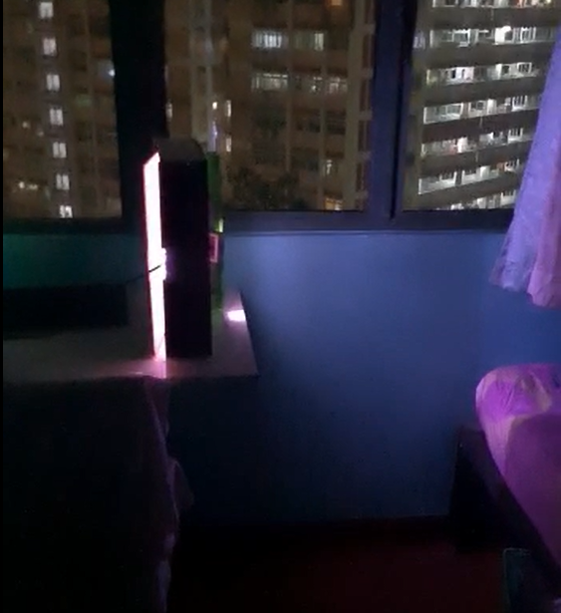
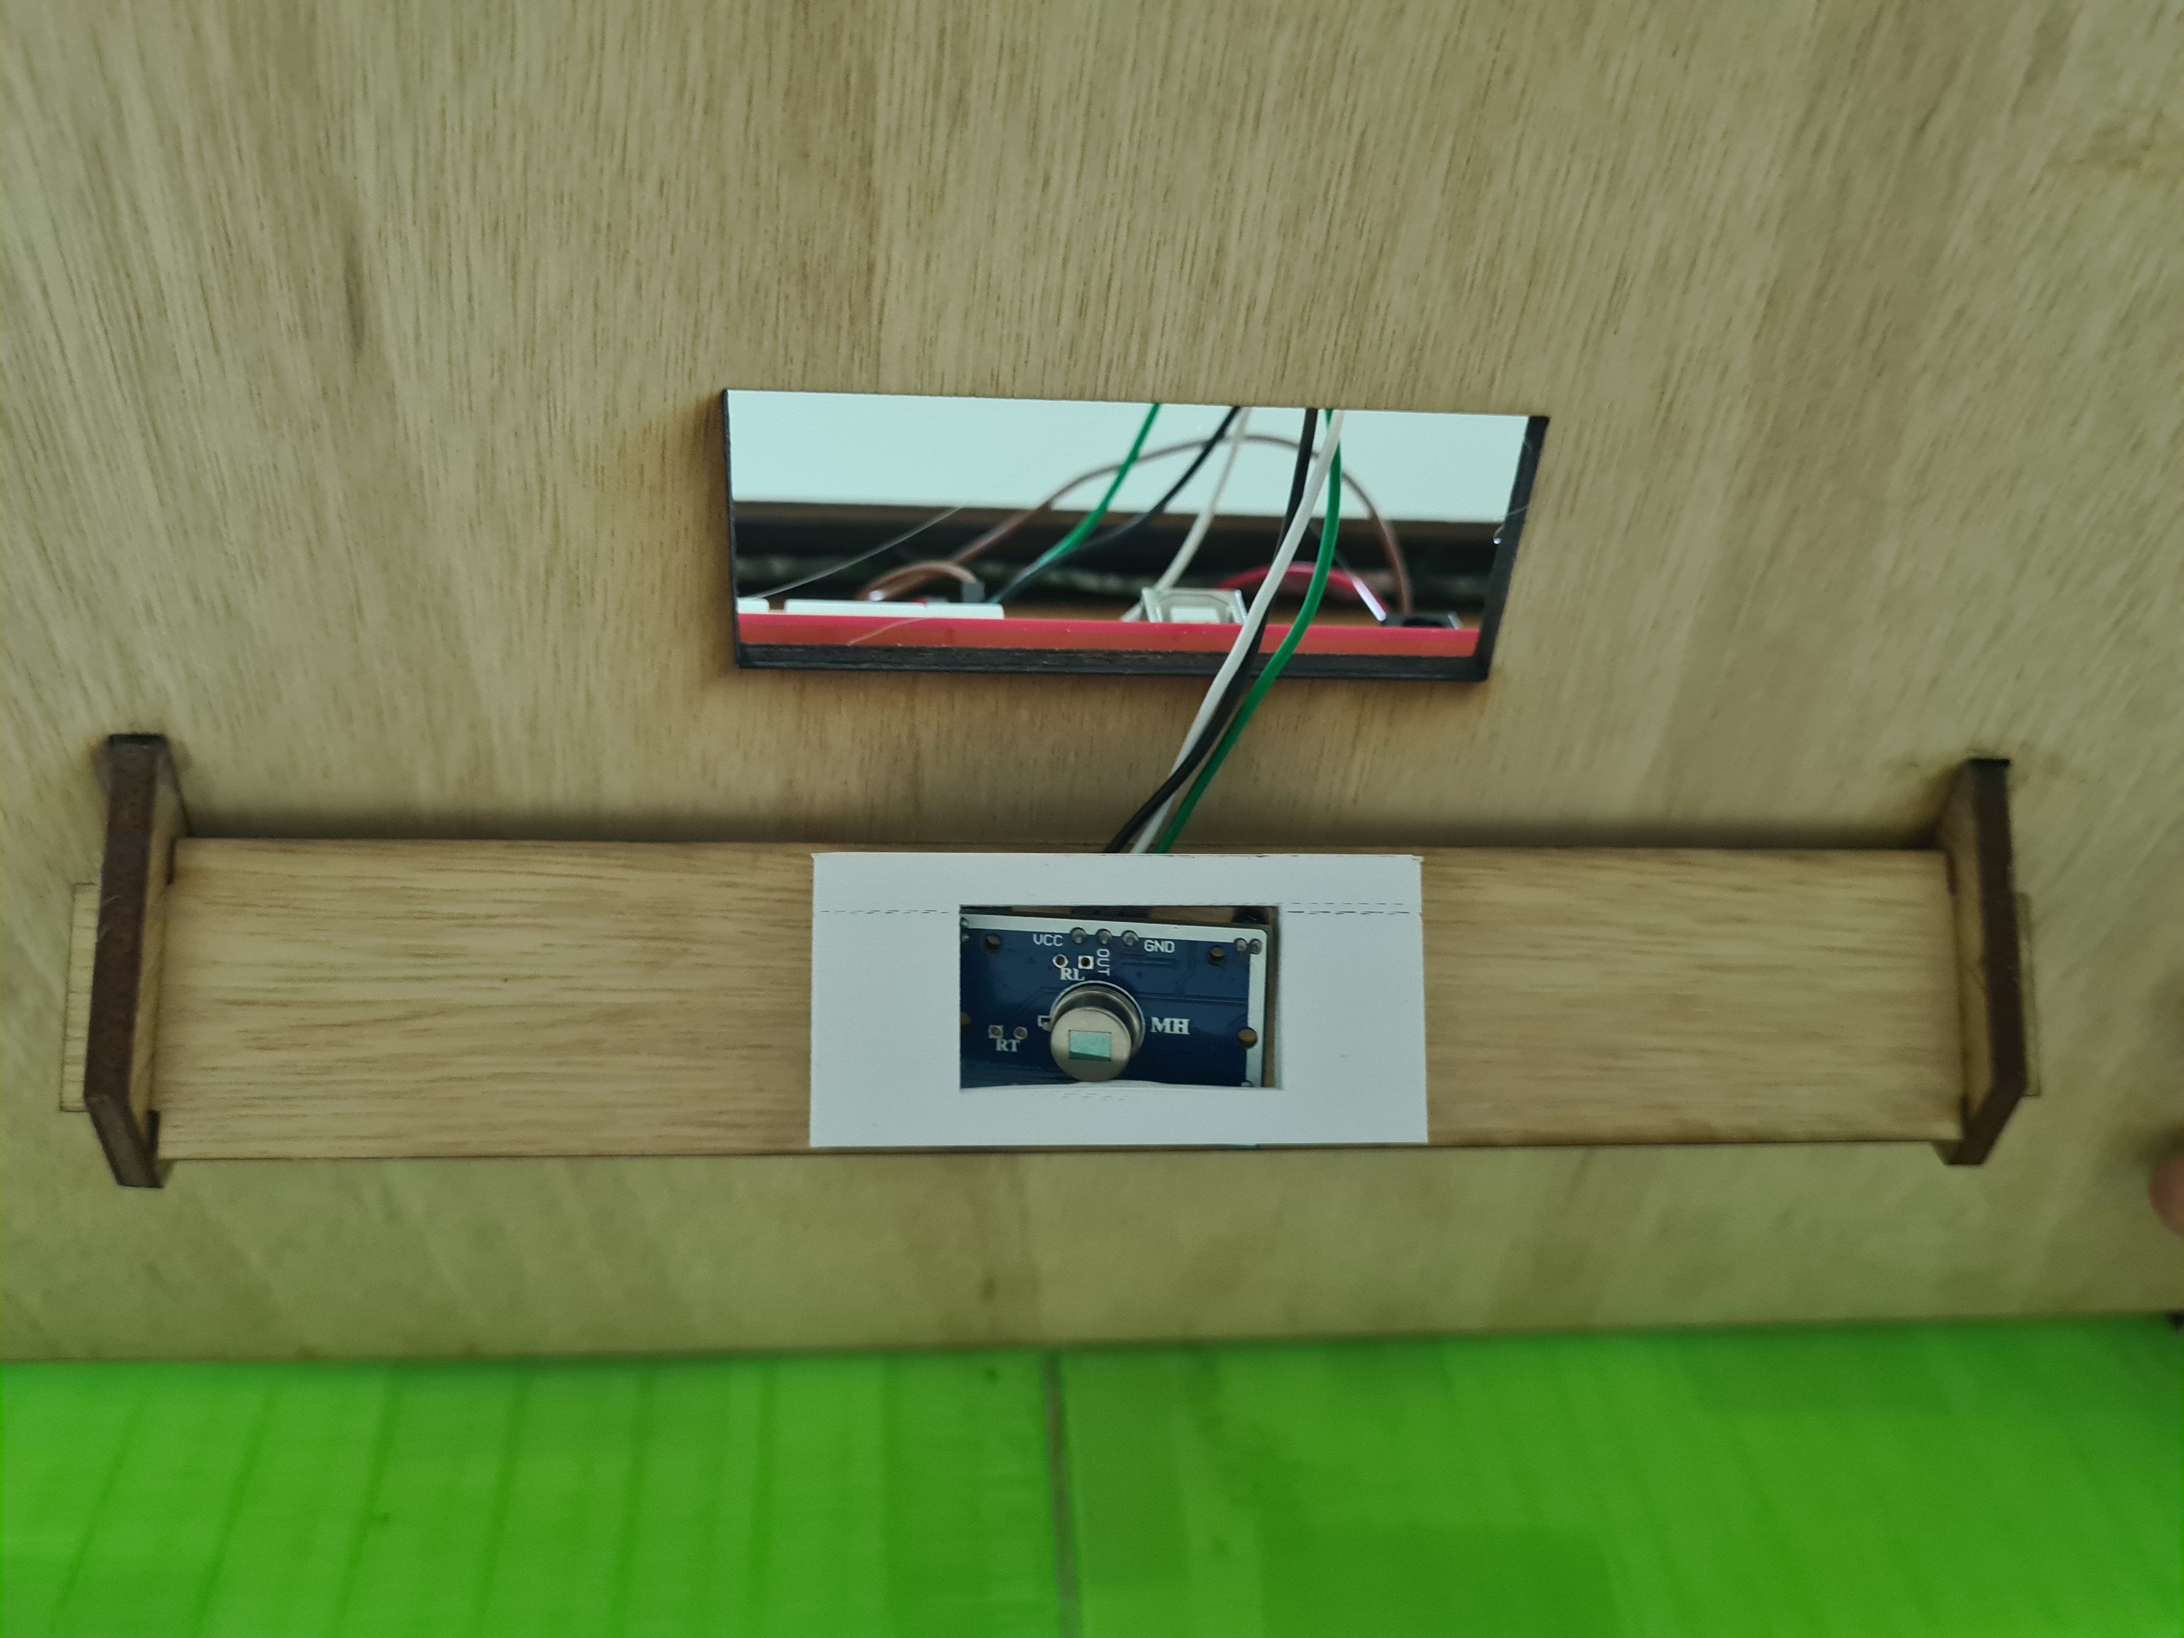
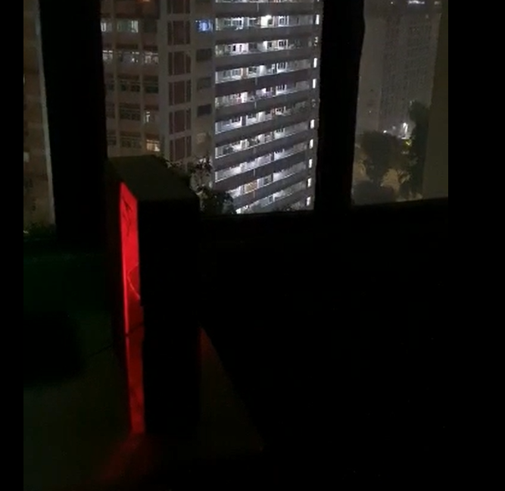
Motion Lights
The motion light project makes use of a motion sensor (PIR Sensor) to detect movement and turn on the light if there is movement
Light Turns On
PIR sensor detects motion
Light Turns Off
PIR sensor doesn’t detect motion

